Slide 1
Musical Instrument Classification Using a Hybrid Neural Network
Landon Buell
Senior, Physics B.S. Major
University of New Hampshire
8 Jan 2020
Kevin Short
University Professor & Professor of Mathematics
Founder, Integrated Applied Mathematics Program
University of New Hampshire

Slide 2
Introduction

Slide 3
Presentation Outline
Introduce the problem that we are going to solve
Develop Neural Networks as the solution
Discuss consequences and improvements to the solution
Analyze the performance of the improvements

Slide 4
Mapping Sounds to Sources
Humans are proficient at mapping sounds to sources
Impractical at a large scale
Computers are not proficient at mapping sounds to sources
Can handle large volumes of data

Slide 5
“Birds inspired us to fly, burdock plants inspired Velcro and nature has inspired many other inventions. It seems only logical then, to look to the brain’s architecture for inspiration on how to build an intelligent machine.”
- Aurelion Geron, Former YouTube Video Classification lead

Slide 6
The Neural Network

Slide 7
Structure
Consider a neural network to be just like mathematical function
Composed of smaller functions called layers
Transform features into predictions

Slide 8
Classification Model
Inputs are properties of digital audio files from London’s Philharmonia Orchestra and University of Iowa’s Electronic Music Studios
Outputs are integers that correspond to musical instruments
We group samples with similar input properties

Slide 9



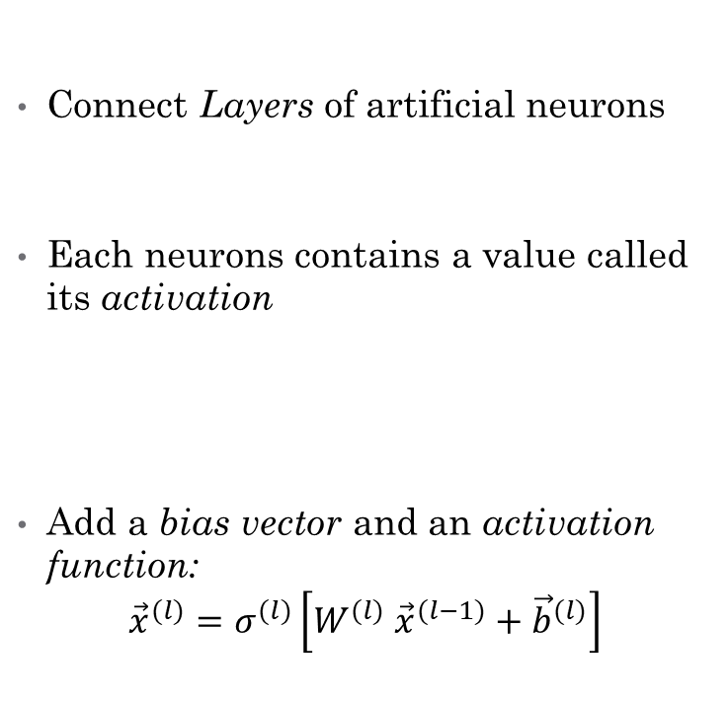



The Multilayer Perceptron (MLP)
Connect Layers of artificial neurons
Each neurons contains a value called its activation
Add a bias vector and an activation function:
$${\vec{x}}^{(l)}=σ^{(l)}\left[W^{(l)} {\vec{x}}^{(l−1)}+{\vec{b}}^{(l)}\right]$$
${\vec{x}}^{(l)}$ =
$W^{(l)}$
${\vec{x}}^{(l−1)}$
$${\overset{⃑}{x}}^{(l−1)}$$
$$W^{(l)}$$
$${\overset{⃑}{x}}^{(l)}$$

Slide 10
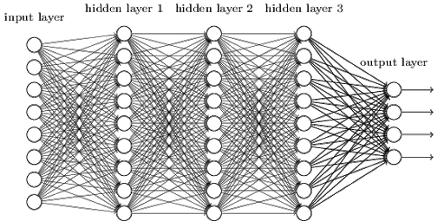
The Multilayer Perceptron (Cont.)
Inputs are 1D, useful for vector-like inputs
Transformed via repeated matrix-vector equations in dense layers
Lots of connections, computationally expensive

Slide 11
Features for the MLP
Time Domain Envelope (x5)
Zero Crossing Rate
Temporal Center of Mass
Auto Correlation Coefficients (x4)
Mel Frequency Cepstrum Coefficients (x12)
Frequency Center of Mass

Slide 12
The Convolutional Network (CNN)

Slide 13
Consequence of the Solutions
Both architectures has experimentally shown individual success
MLP and CNN use different forms of inputs they are initially incompatible
We want to combine them to form a Hybrid Neural Network

Slide 14
Hybrid Network Architecture

Slide 15
Two Modes of Input
Each model uses a different input Modes
1D Feature Vector vs.
2D Spectrogram Image
Compare Modes to human senses

Slide 16
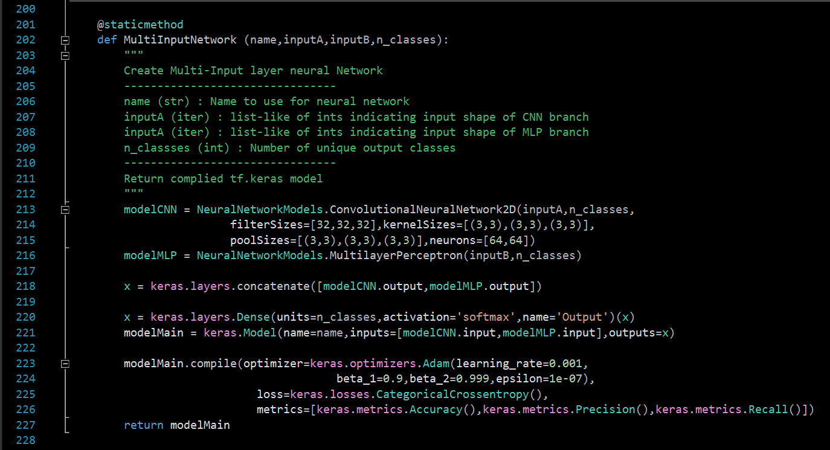
Implementation (Tensorflow.keras)
Create each input Branch as its own model
Concatenation of each model’s output activations
Create combined output layer, wrap as single model instance
Compile the model, prepare for training/testing
Return the hybrid network instance

Slide 17
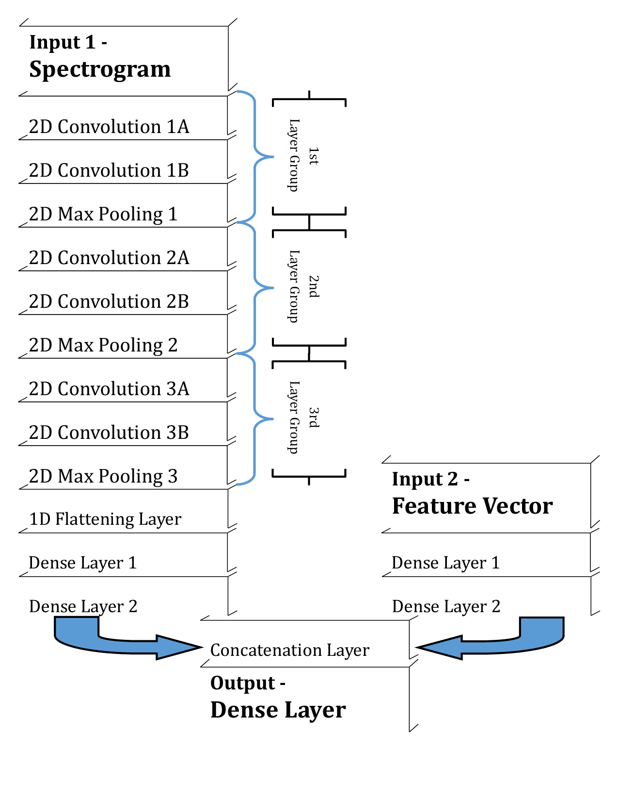
Hybrid Neural Network Architecture

Slide 18
Modifying the Solution
Providing two representations for each sample
This is called multimodal learning

Slide 19
Performance of the Hybrid Model

Slide 20
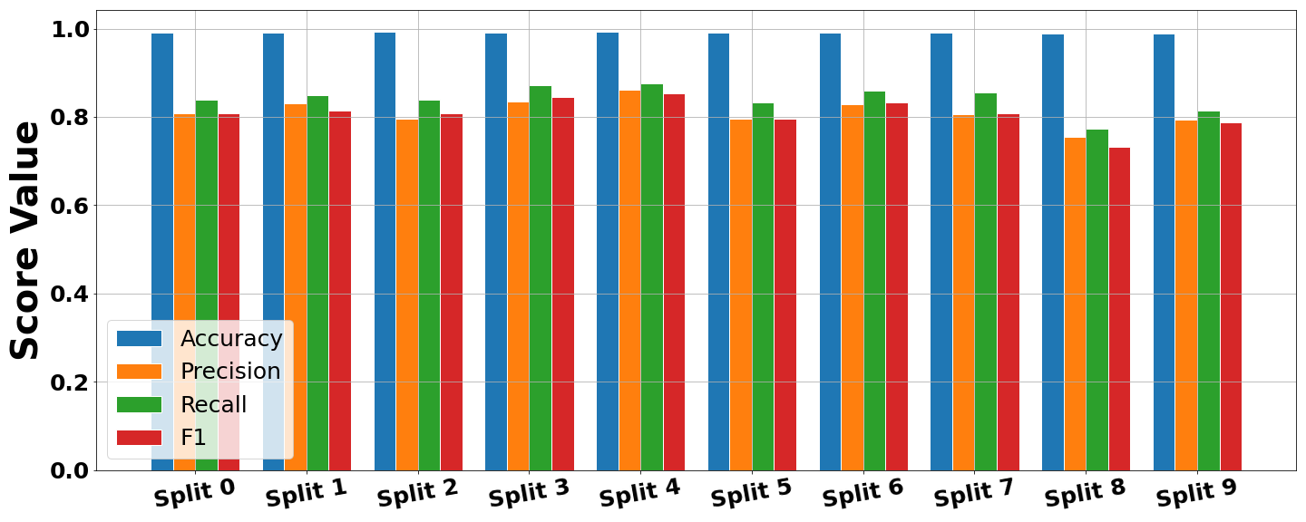
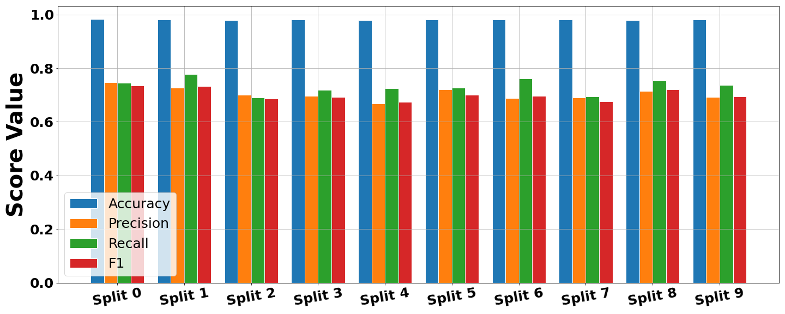
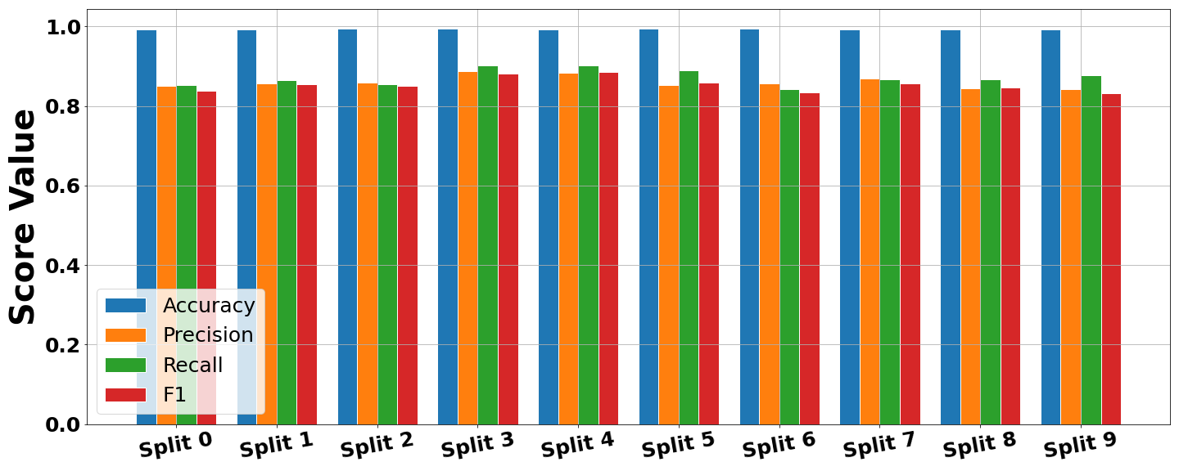
X-Validation Performance
1)
Compare three variants
CNN Architecture
MLP Architecture
Hybrid Architecture
Hybrid network shows generally higher performance scores
2)
3)

Slide 21
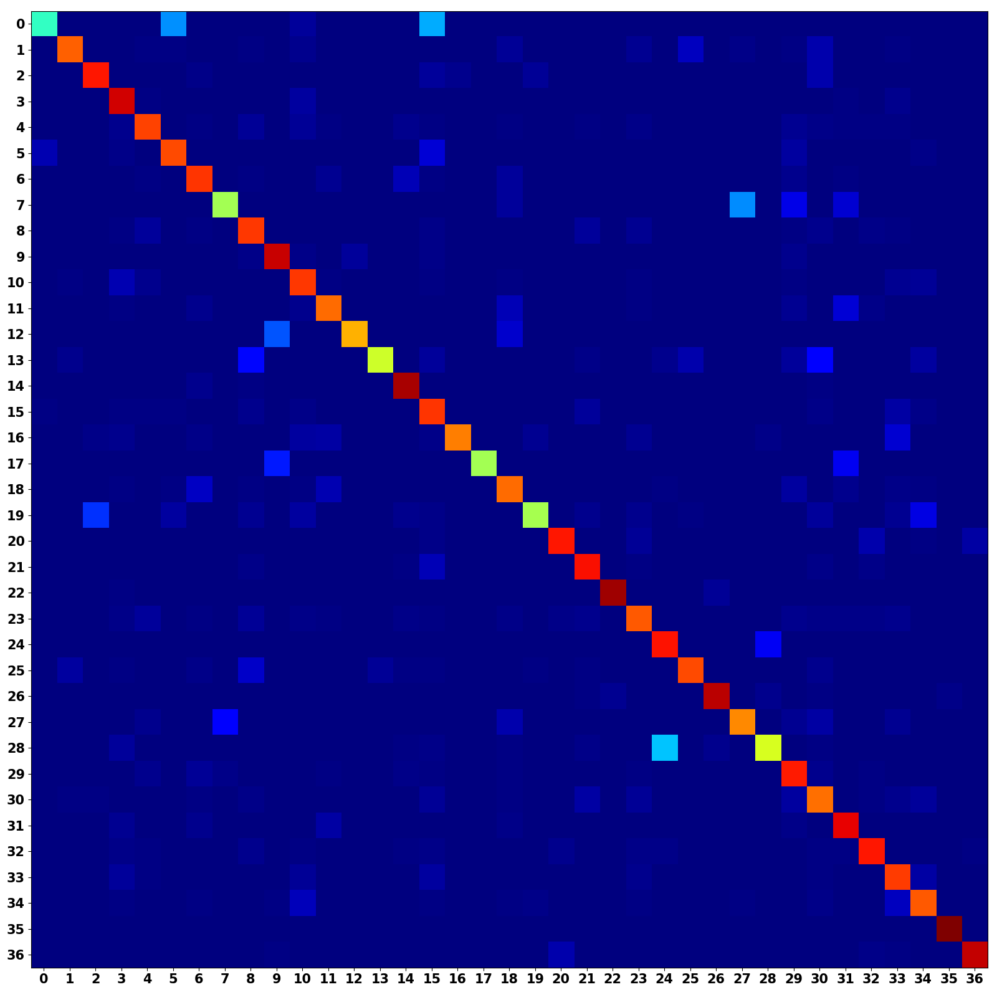
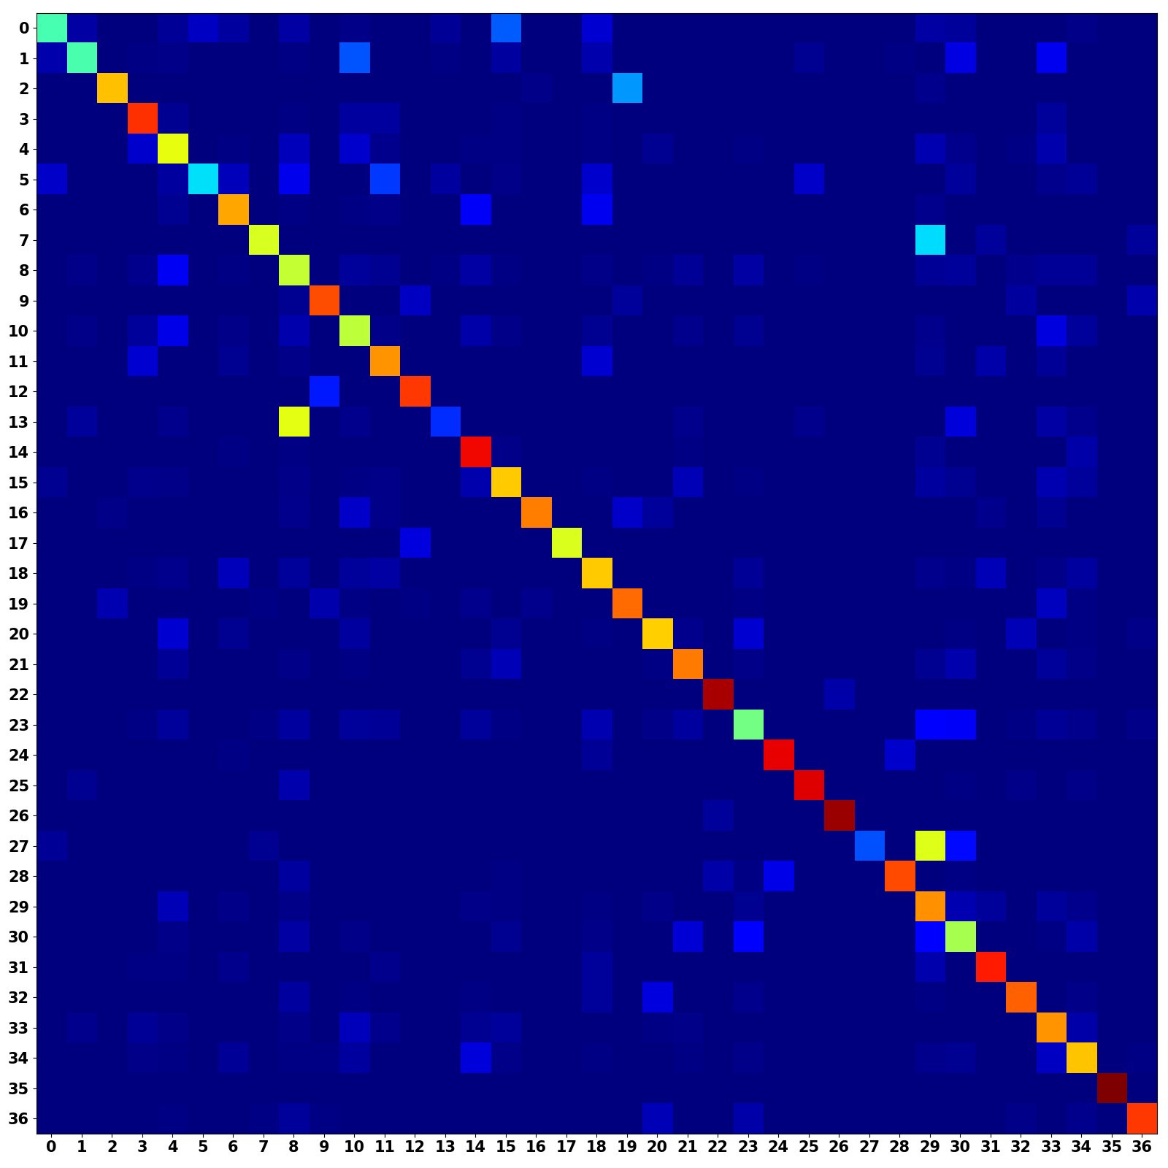
Unimodal Confusion Matrices
CNN Branch (Occurrence Weighted)
MLP Branch (Occurrence Weighted)
Frequent misclassifications
Strong main diagonal, reasonable performance
Related classes?
Poor features choice?

Slide 22
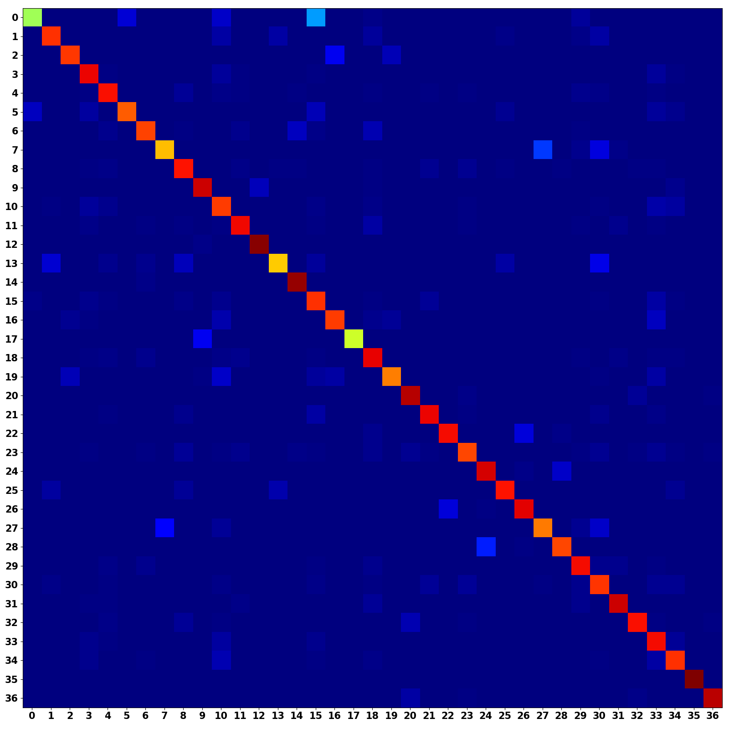
Multimodal Confusion Matrix
CNN + MLP (Occurrence Weighted)
Multimodal models shows a stronger main diagonal
Combines predictive power from both architectures

Slide 23
Discussions
Hybrid networks allows for multimodal learning
Opens the door to other related classification tasks
Many uses outside digital audio recognition
Cardiograph + Biometric readings
Speech + text translations

Slide 24
Conclusions
The hybrid network shows improved classification performance over either unimodal model
Allows for more reliable classification of digital audio files to musical instruments

Slide 25
Citations
[1] Geron, Aurelien. Hands-on Machine Learning with Scikit-Learn and TensorFlow: Concepts, Tools, and Techniques to Build Intelligent Systems. O’Reilly, 2017.
[2] Goodfellow, Ian, et al.Deep Learning. MIT Press, 2017.
[3] Khan, M. Kashif Saeed, and Wasfi G. Al-Khatib. “Machine-Learning Based Classification of Speech and Music.” Multimedia Systems, vol. 12, no. 1, 2006, pp. 55–67., doi:10.1007/s00530-006-0034-0.
[4] Li, Yingming, and Ming Yang. “A Survey of Multi-View Representation Learning.” Journal of LateX Class Files, vol. 14, no. 8, Aug. 2015.
[5] Liu, Zhu, et al. ”Audio Feature Extraction and Analysis for Scene Segmentation and Classification.” Journal of VLSI Signal Processing, vol. 20, 1998, pp. 61–79.
[6] Ngiam, Jiquan, et al. ”Multimodal Deep Learning.” 2011.
[7] TensorFlow: Large-scale machine learning on heterogeneous systems, 2015. Software available from tensorflow.org.
[8] Virtanen, Tuomas, et al. Computational Analysis of Sound Scenes and Events. Springer, 2018.
[9] White, Harvey Elliott, and Donald H. White. Physics and Music: the Science of Musical Sound. Dover Publications, Inc., 2019.

Slide 26
Questions?
Additional information, GitHub Repository, and Formal Write-Up is Available
Landon Buell – lhb1007@wildcats.unh.edu
Kevin Short – kevin.short@unh.edu

Slide 27
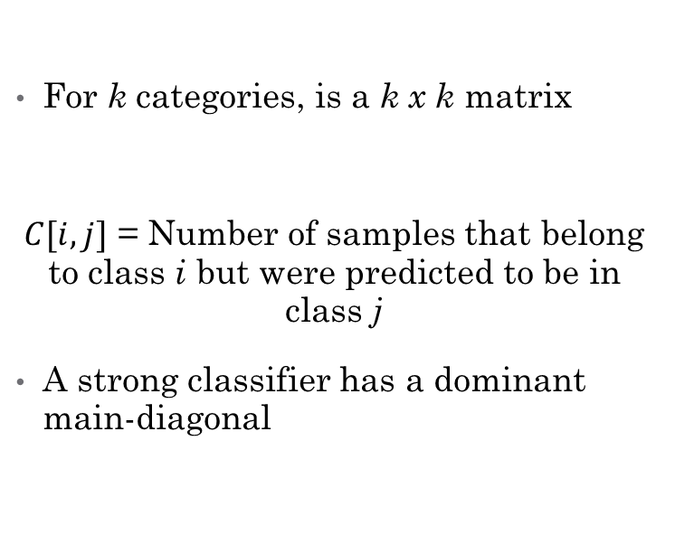
Appendix – Confusion Matrices
Standard Confusion Matrix
Occurrence Weighted Matrix
For k categories, is a k x k matrix
$C[i,j]$ = Number of samples that belong to class i but were predicted to be in class j
A strong classifier has a dominant main-diagonal
Create same as standard matrix
Divide each row by sum of the row
Accounts for non-uniform number of samples in each class

Slide 28
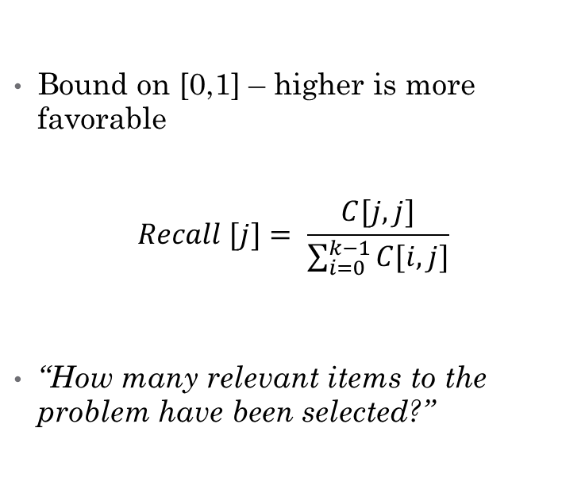
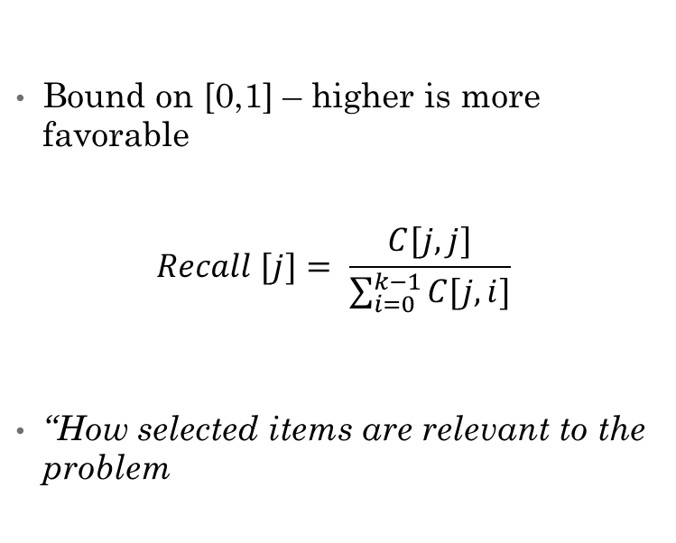
Appendix - Metrics
Precision / Sensitivity Score
Recall / Specificity Score
Bound on [0,1] – higher is more favorable
$$Recall [j]= \frac{C[j,j]}{\sum_{i=0}^{k−1}{C[j,i]}}$$
“How selected items are relevant to the problem
Bound on [0,1] – higher is more favorable
$$Recall [j]= \frac{C[j,j]}{\sum_{i=0}^{k−1}{C[i,j]}}$$
“How many relevant items to the problem have been selected?”

Slide 29
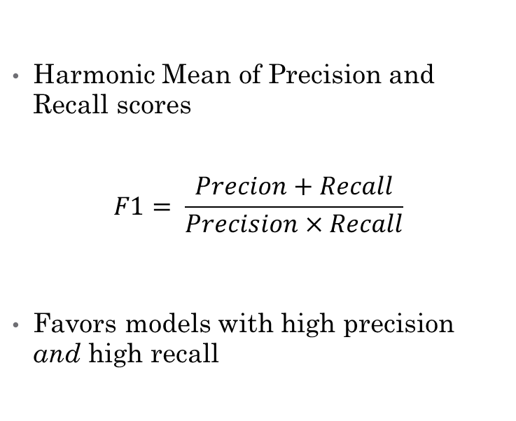
Appendix – Metrics (Cont.)
Accuracy Score
F1 Score
Ratio of correct predictions to total predictions
Often misleading, not commonly used
Does not account for non-uniform number of samples in each class
Harmonic Mean of Precision and Recall scores
$$F1= \frac{Precion+Recall}{Precision×Recall}$$
Favors models with high precision and high recall

Slide 30
Appendix – Tensorflow / Keras
Free, open sources Python library centered around Deep Learning
High-Level API for constructing neural networks and Computational graphs
Developed and maintained by Google
https://www.tensorflow.org/
Offers tools for hardware acceleration on certain GPUs

